Slide 1


Microfinance in Africa: Experience and Lessons from Selected African Countries
Prepared by Anupam Basu, Rodolphe Blavy, and Murat Yulek1
IMF Working Paper – African Department
Presented by Liyu Li, MSFQ student at WUSTL

Slide 2
Main Idea:
microfinance institutions complement effectively the banking sector in extending financial services and draw on the rich experience of community-based developments of financial intermediation in Africa.

Slide 3

CONTENTS
1. Introduction
2. Deposit Collection and Credit Extension in the Microfinance Sector
3. Links Between the Operations of MFIs and Banks, Donors and NGOs
4. The Role of Governments
5. Conclusions & Comments

Slide 4

1. Introduction

Slide 5
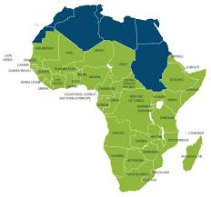
1. Introduction
Small enterprises and most of the poor population in sub-Saharan Africa have very limited access to deposit and credit facilities and other financial services provided by formal financial institutions.
Microfinance institutions (MFIs) in Africa:
Provided credit, deposit, credit facilities
The selected African countries:
Benin, Ghana, Guinea, and Tanzania
The main contribution of the paper:
Compare experiences across Africa, and identify patterns that may guide public policy in the sector.

Slide 6
2.Deposit Collection
& Credit Extension
in MFIs

Slide 7
2. Deposit Collection & Credit Extension in MFIs
The importance of deposit collection in the development of microfinance services:
The poor value both deposit and lending services for the purpose of financial cushion, current input and future event( access, security, liquidity, and return)
MFIs have provided the means for overcoming three main barriers to the use of the deposit facilities commonly offered by banks (as identified by the World Bank, 1997):
high opening and minimum account balances
high travel time and transport costs involved in making deposits and withdrawals at the bank branch
lack of familiarity with bank branch operations and procedures.
（3）

Slide 8
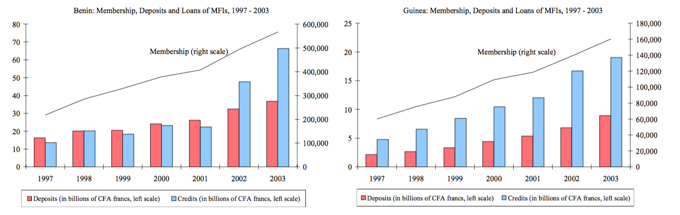

2. Deposit Collection & Credit Extension in MFIs
2.1 The Community-Based Approach in MFI Development
In Benin and Guinea, the figures below indicate that the rapid increase in MFIs’ membership and loan activities was supported by a continued increase in deposits.
（3）

Slide 9

2. Deposit Collection & Credit Extension in MFIs
2.1 The Community-Based Approach in MFI Development
Community-based cooperative approach:
Cooperative banking and savings and credit associations
Benin: Saving and loan cooperatives and mutuals (SLCs)
Ghana: Rural and Community Banks (RCBs)
& the Savings and Loans companies (S&Ls)
（3）

Slide 10
2. Deposit Collection & Credit Extension in MFIs
2.1 The Community-Based Approach in MFI Development
Grameen Bank Group-Savings Schemes Benefits:
For group members: Constitute larger collaterals and enhance their access to credit services.
for the collecting institution: Economies of scale and operate on a full- intermediation basis
At the macroeconomic level: Deposit collecting institutions can help to increase domestic financial savings mobilization by tapping the resources of the poor who are otherwise isolated from the formal financial system
Others: Empower underprivileged social constituencies to contribute more effectively to economic development and poverty reduction.
（3）

Slide 11
2. Deposit Collection & Credit Extension in MFIs
2.1 The Community-Based Approach in MFI Development
Example of Grameen Bank Model:
In a group savings with credit scheme: a group of members mobilize and pool their savings jointly to qualify for a loan & use group savings as security against loans.
In a group and individual savings with credit scheme: group and individual savings accounts coexist, both of which can be used as collateral. Loan repayments are made individually but handled through the group account
With individual savings with group lending: the group handles the collection of individual savings, receives the loan for distribution to members, and bears group responsibility for recovery.
（3）

Slide 12
2. Deposit Collection & Credit Extension in MFIs
2.2 Formalizing Informal Methods of Financial Intermediation
Building on Informal Sector Savings and Credit Mechanisms: The Example of the Ghana Susu System
1. Susu collectors: offer a saving vehicle by collecting daily amounts voluntarily saved by their clients, which they returned at the end of the month, minus one day’s amount as a commission. The susu collector function was expanded by licensed MFIs with “Mobile Banking” services working as a collector going locally to mobilize savings and offering additional services
2. Susu associations: are either (i) rotating (ROSCAs), that is, they collect savings from their members and allocate them to each member in turn, or (ii) accumulating, which allow regular contributions to be accumulated, to cover the lump sum costs of such special future events as funerals.
（3）

Slide 13
2. Deposit Collection & Credit Extension in MFIs
2.2 Formalizing Informal Methods of Financial Intermediation
Building on Informal Sector Savings and Credit Mechanisms: The Example of the Ghana Susu System(cont.)
3. Susu clubs: combined the above two systems, operated by a single agent. Members commit to save a pre-defined amount over the medium-term (50- to 100-week cycles) and pay commissions on each payment and fees when they are advanced the targeted amount before the end of the cycle.
4. Susu companies: are more recent (late 1980s) and registered. In addition to savings collected using traditional susu collectors, they provide loans after a minimum saving period.
（3）

Slide 14
2. Deposit Collection & Credit Extension in MFIs
2.3 Looking for Financial Sustainability
The reason for the formalizations of informal techniques & group-based instruments:
To deal with asymmetry of information, lack of collateral, and difficult enforcement of legal rights (linking of savings and credit program, peer pressure, self-selection)
But, A number of limits/risks may exist in group lending schemes with joint liabilities:
1. Under a group lending scheme, the burden of risk borne by an individual member of the group is higher than it would have been under a limited liability scheme.
2. A default by one borrower affects the credit rating of the group as a whole and causes it to default.
3. A coordination failure problem as individual borrowers have an incentive to default when they expect other individual members of the group to fail.
（3）

Slide 15
2. Deposit Collection & Credit Extension in MFIs
2.3 Looking for Financial Sustainability
Approach to deal with the risk:
1. Sequential lending: Loans are provided sequentially to different sub-groups of borrowers participating in a given group lending scheme
2. self-selection: group formation among good credit risks, addressing partially the problem of imperfect information faced by the lender, and thereby lowering the overall risk of the group lending scheme.
（3）

Slide 16
3. Links Between
Several Parties

Slide 17
3. Between the Operations of MFIs and Banks, Donors and NGOs
3.1 Developing Complementarities between MFIs and Banks
Serve different client base:
Banks: Lend and collect deposits mostly from a limited formal private sector and to the government
MFIs: Service poor and rural households, and small entrepreneurs often in the informal sector
（3）

Slide 18
3. Between the Operations of MFIs and Banks, Donors and NGOs
3.1 Developing Complementarities between MFIs and Banks
Commercial Banks
MFIs
liquidity management services
extended credit facilities
extending their outreach and achieving economies of scale
strengthening the links between the formal and informal sectors
（3）

Slide 19
3. Between the Operations of MFIs and Banks, Donors and NGOs
3.2 The Roles of Donors and NGOs
NGOs and donors have tended to focus on social programs and services for which they have particular expertise
Direct Support from NGOs have adverse effects on the operation of MFIs:
NGO support could weaken financial discipline in MFIs, and dependence on donor money rather than deposit mobilization could constrain growth and sustainability
It could crowd out commercially viable projects that would not qualify for donor funds
（3）

Slide 20
4. The Role of
Governments

Slide 21
4. The Role of Governments
Reality:
State-owned Banks failure – large loss- restructured/ recapitalized/ privatized/ liquidated
Regulation systems cycle:
Easy entry – weak performance – tightening up of regulation & restructuring
（3）

Slide 22
4. The Role of Governments
4.1 Objectives and Coverage of the Regulatory Framework
Benin: dedicated microfinance law, which covers saving and loan cooperatives (SLCs) , while credit-only institutions are regulated through individually signed framework agreement
Ghana: activities of rural credit banks (RCBs) are regulated under the Commercial Bank Act; S&Ls, on the other hand, are regulated under the Nonbank Financial Institutions Law, again with certain specific restrictions.
Guinea: microfinance activities are regulated by central bank instructions at present, while a microfinance law is being prepared.
Tanzania: formal microfinance institutions are subject to the provisions of the banking regulation and supervision while semi-formal institutions are subject to the Cooperative Societies Act and are supervised by Ministry Cooperatives.
（3）

Slide 23
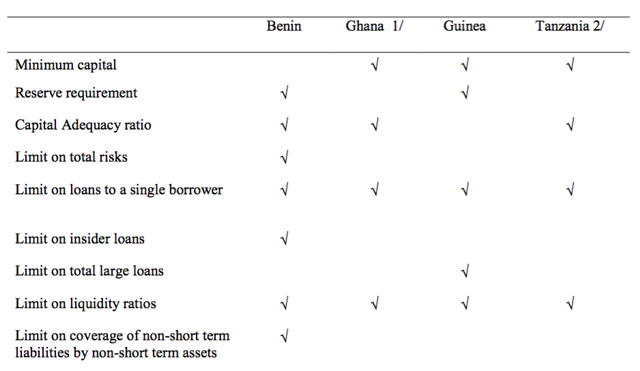
4. The Role of Governments
4.2 Minimum Regulatory Requirements and Supervision Practices
（3）

Slide 24
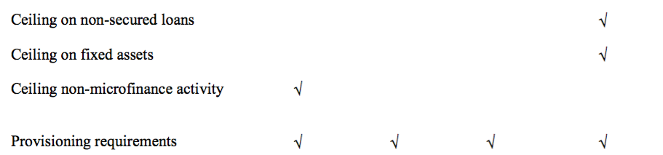
4. The Role of Governments
4.2 Minimum Regulatory Requirements and Supervision Practices
（3）

Slide 25
4. The Role of Governments
4.3 Accompanying Measures
Measures on the compliance with regulatory requirements:
Capacity building: bookkeeping, reporting standards, strengthening of internal controls and credit decision mechanisms, and improving technology and human resources
Capacity Constraints: ensuring competence and effectiveness and focus
Borrower database development
Enforcement of microfinance regulations & general business related laws
（3）

Slide 26
5. Conclusions
&
Comments

Slide 27


5. Conclusion
Sector | Contents
MFIs | Group-based savings & Informal MFIs
Banking System | Linkage expands their resource base through deposit collection
NGO& Donors | played an important supportive role in the development of MFIs in sub-Saharan Africa
Governments | play a key role in promoting the microfinance sector by putting in place the necessary laws, regulations

Slide 28
5.Comments
Type | Contents
Pros | Practical and Thorough Well- Structured Clear Center View & Analysis
Cons | Lack of quantitative evidence Limited country involved Lack of future overview

Slide 29

THANKS

